Slide 1

Vizard
An gamified Visa Consulting AI Bot

Slide 2





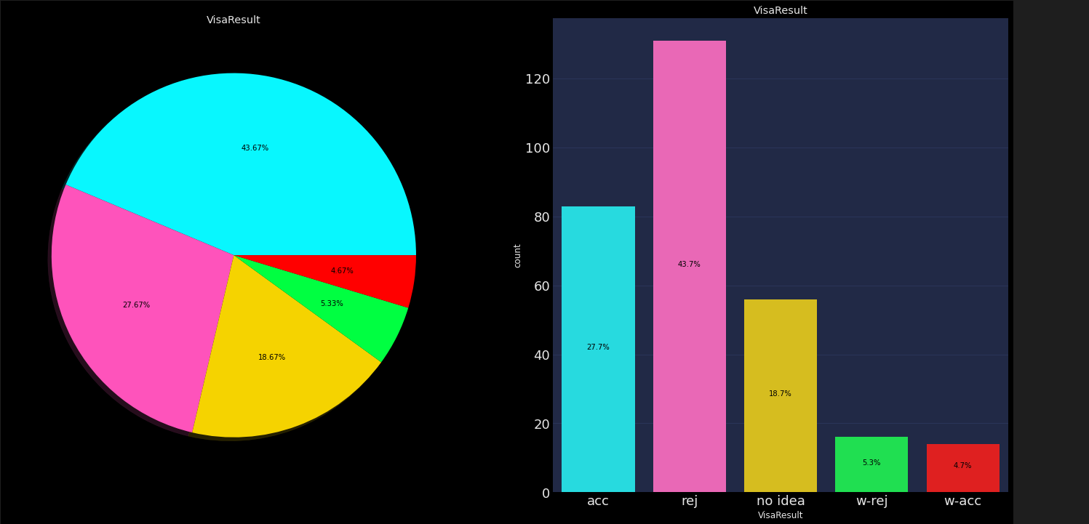


Data
<breakfast_menu>
<food>
<name>Belgian Waffles</name>
<price>$5.95</price>
<description>blah blah</description>
<calories>650</calories>
</food>
</breakfast_menu>
PDF Forms
Gather raw data
More on this later
Other (Travel, bank)
Missing data
Wrong data
Multiple application for the same person (merge)
No Database: manually finding the latest data and
structuring it (which file where)
Feature Eng.
All data fixed
+
4+ months
10% of data has “weak” labels
18% of data has NO label
+
Snorkel
Reduced to 5%
No label is ever recorded
1.5 month

Slide 3


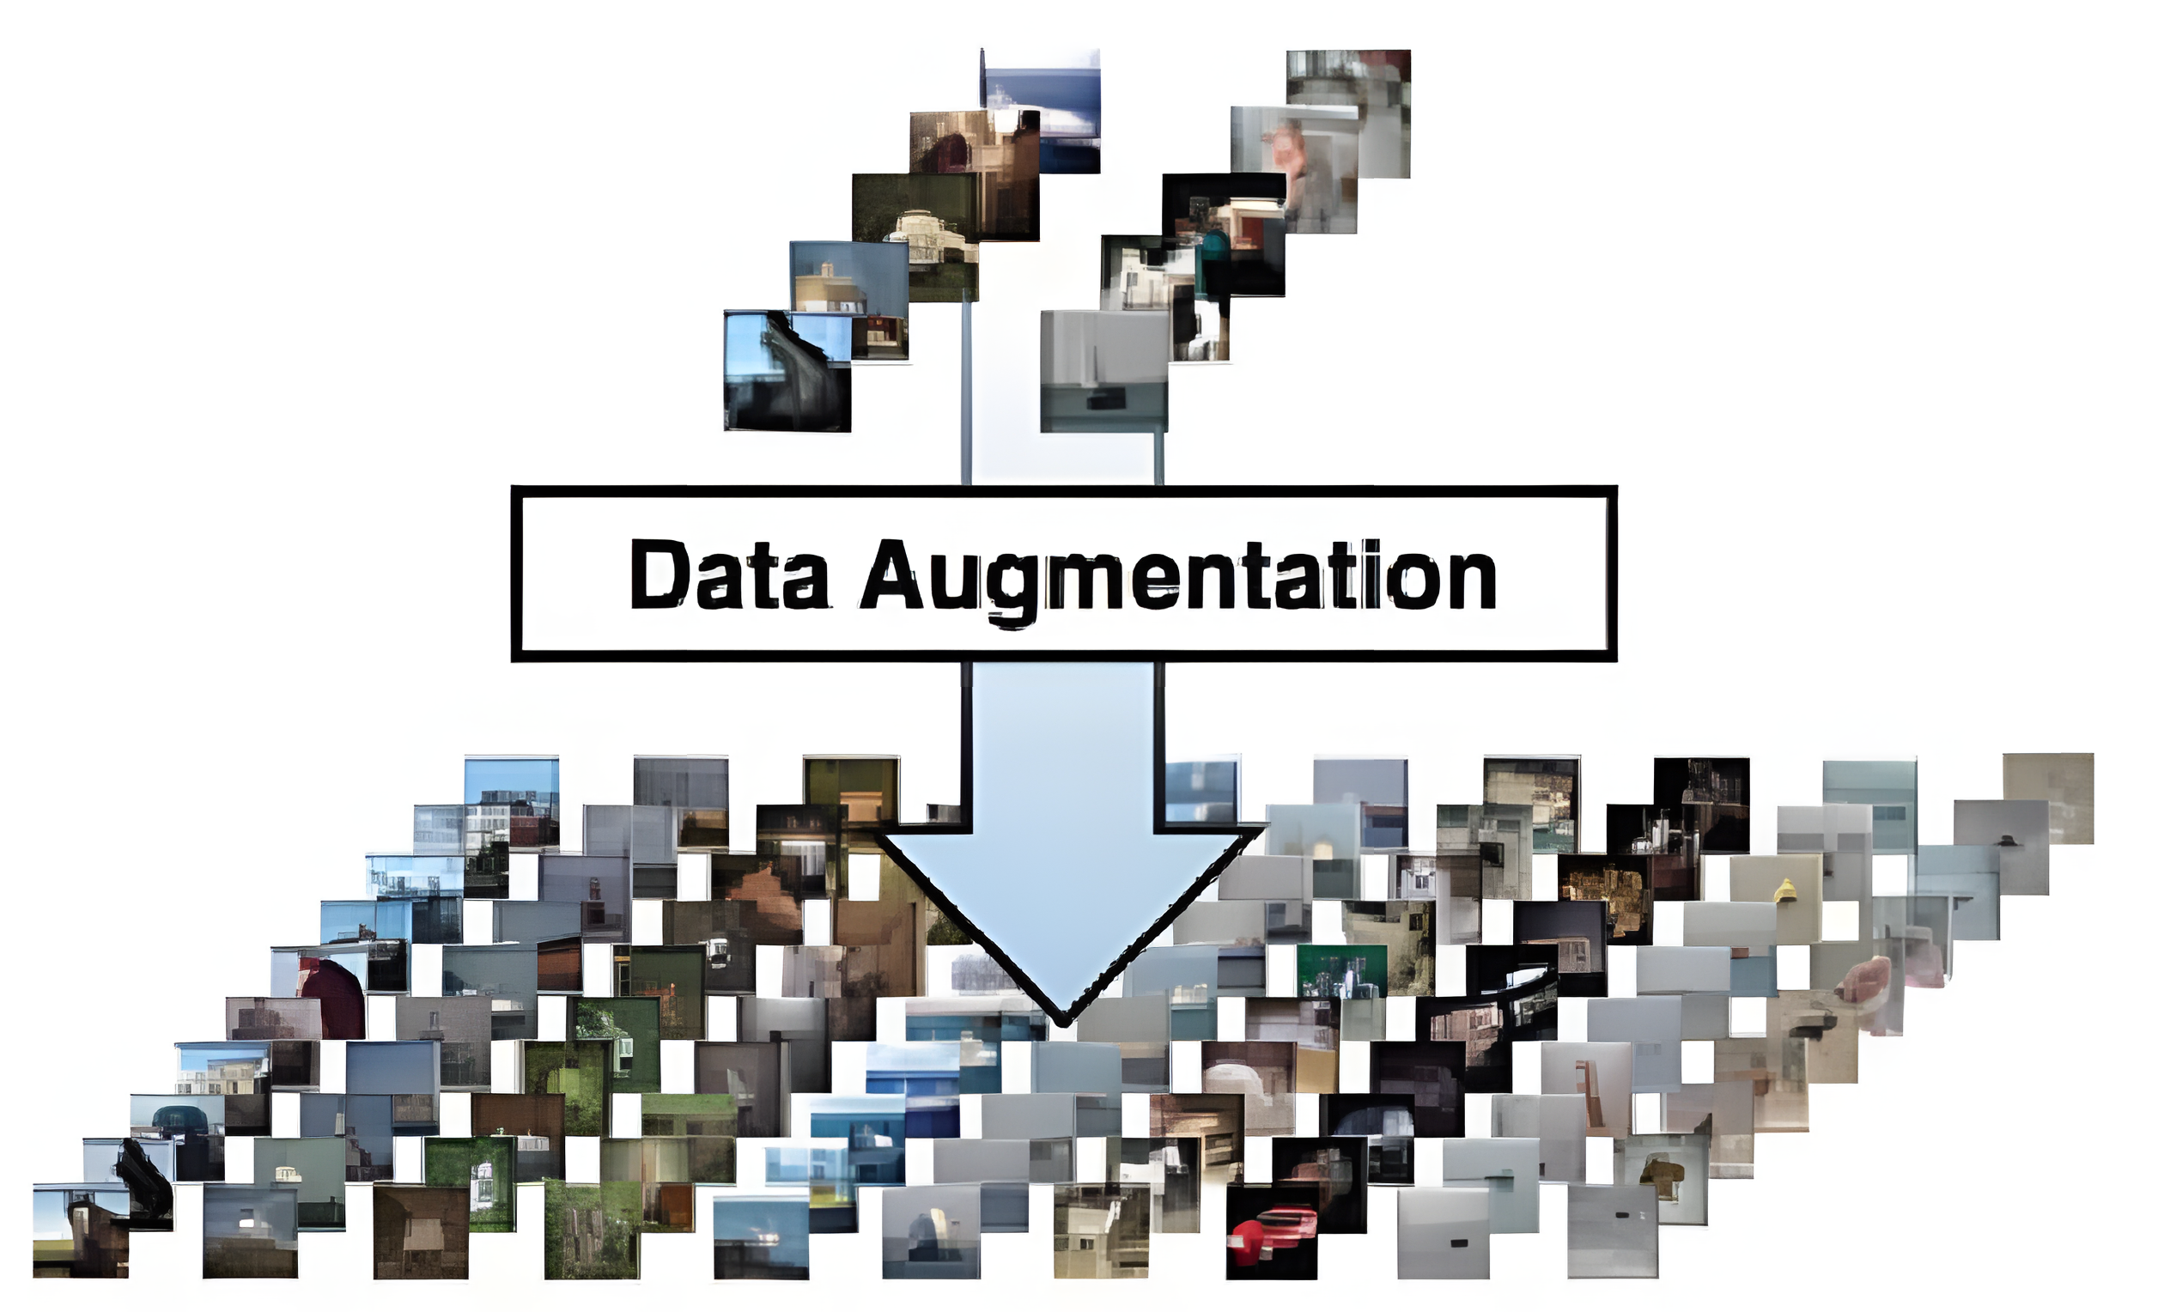
Data Preprocessing
Cleaning
Feature Engineering
Augmentation
Categorical
As-Is
Continuous
As-Is
String
Sex
Marital Status
Children Count
Age
Duration of Stay
As-Is
Transformed
Occupation (ordered)
Relation of Visit (hotel, f1, f2,…)
Transformed
Country (eco, infra score)
Duration of Stay
Transformed
Address to City name
Feature | Value
Missing: Spouse country of birth | Common sense
Missing: Mother/Father Age | Average difference of age of parents and children
Typo: Typop! | Typo
Wrong: Education period (last degree) | People put all degrees combined
Generally “None” | Filled with most common
Feature | Value_{old} | Value_{new} | Method
Continuous(age, job xp, marriage period) | 30 | 30.8 | Gauss
Categorical (gender of child, sibling) | “daughter” | “son” | Flip
Continuous(Number of children, people accompanying) | 2 | 3 | Truncated Count (does not make zero or max)

Slide 4
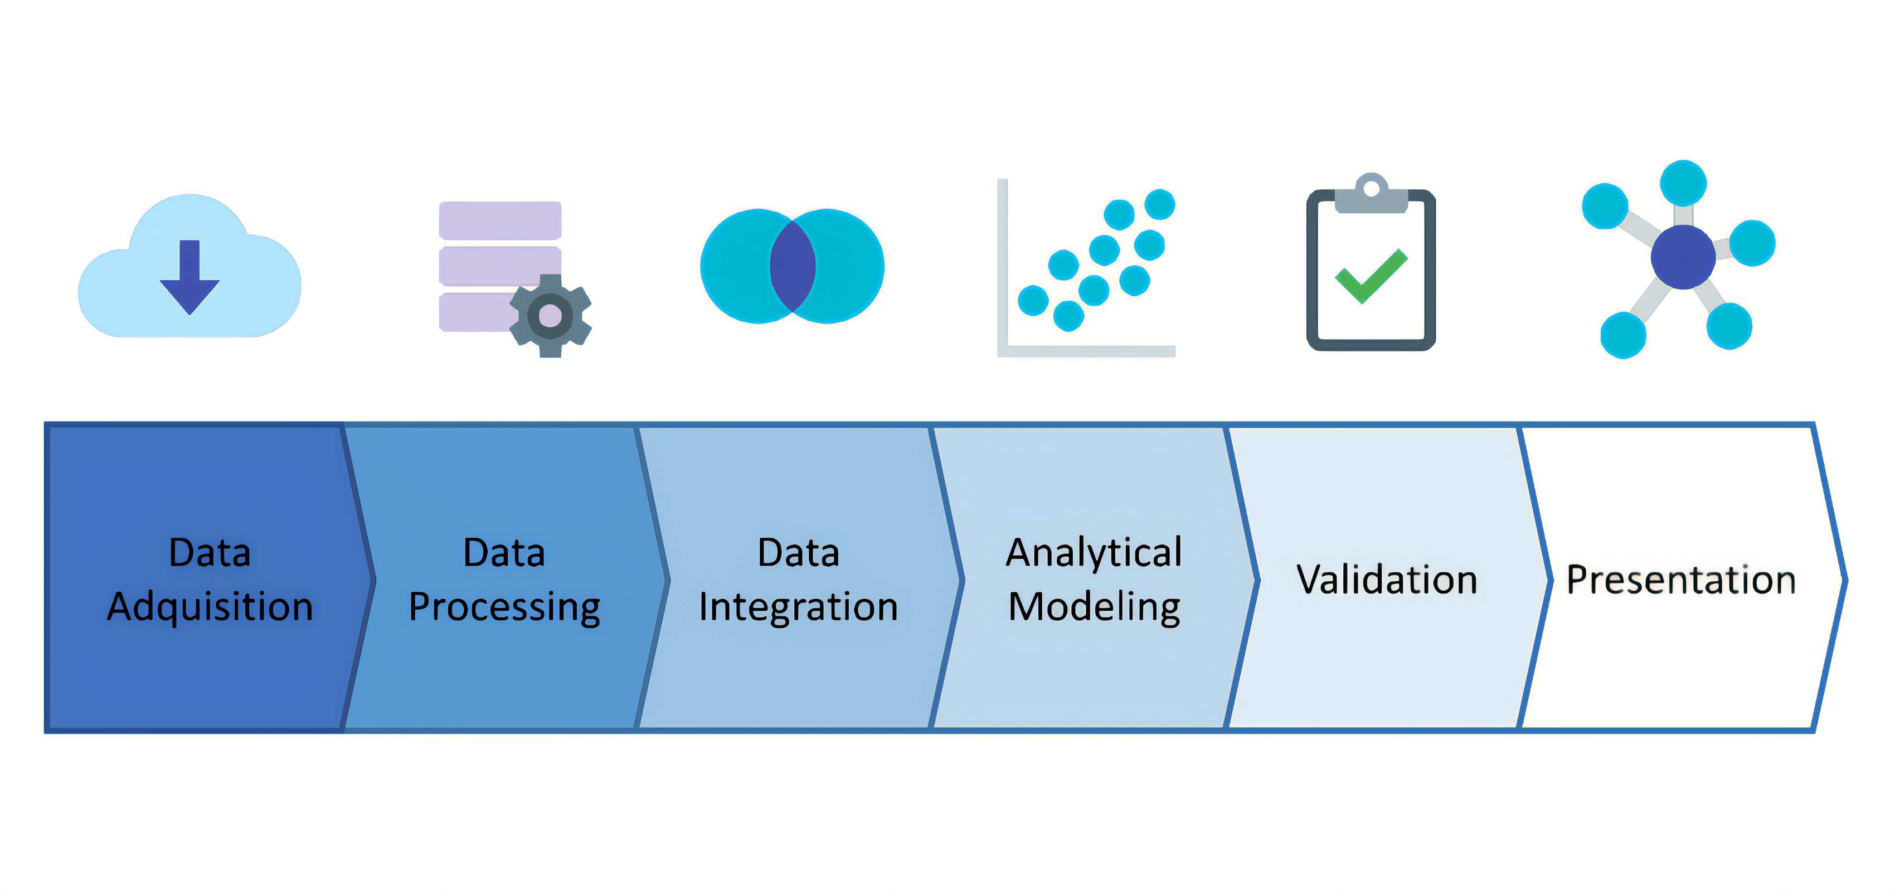
Modeling
covered
Don’t worry!
API, Front

Slide 5
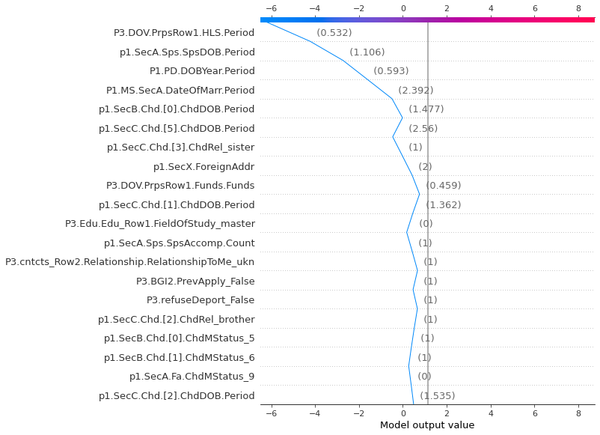
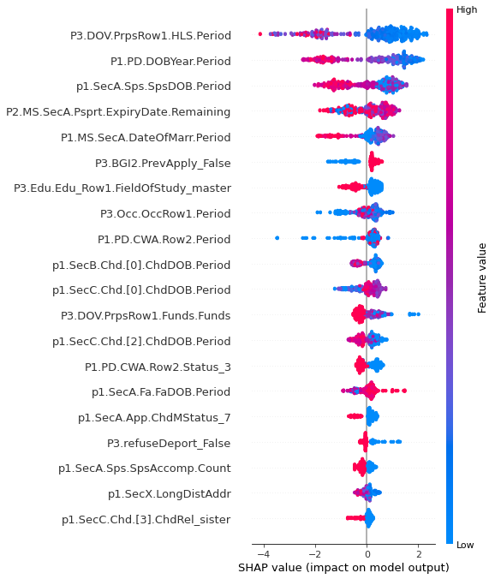
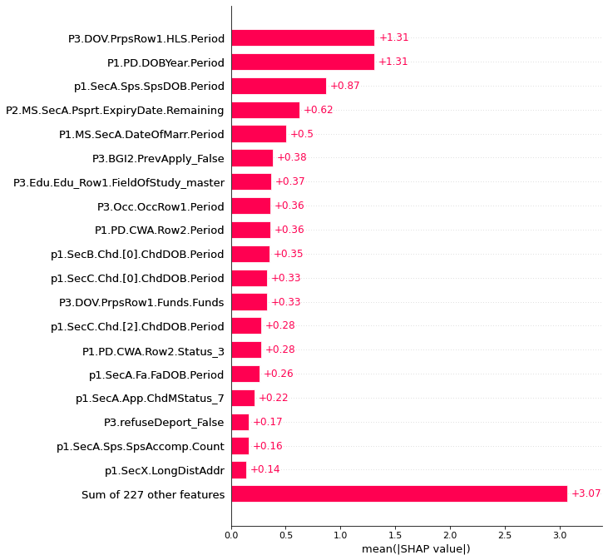
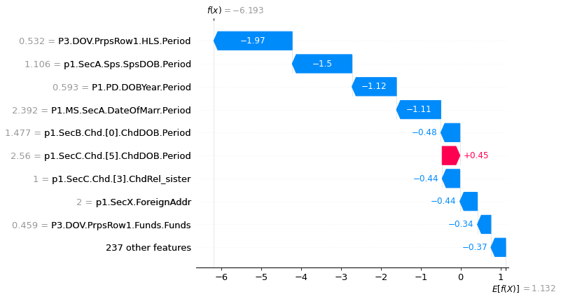
Presentation
XAI

Slide 6
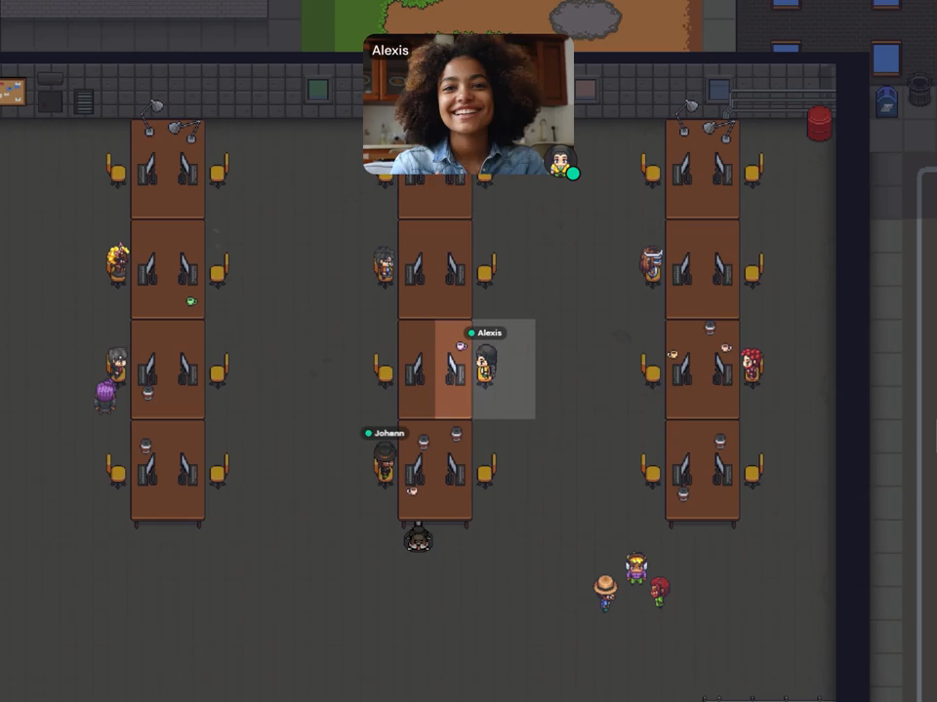
Presentation (Concept)

Slide 7
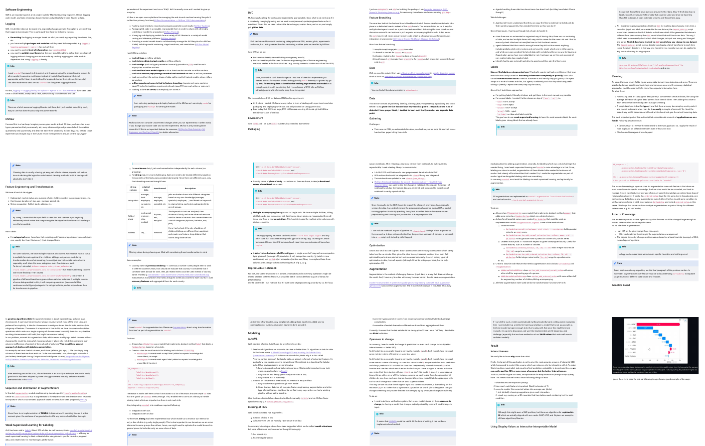
Technical Details

Slide 8
Thank You

